Slide 1
CUSTOMER RETENSION
DATA ANALYSIS
AKSHATHA ARAVIND

Slide 2
BASIC DETAILS
SHAPE : (269, 71)
DATA SET CONSIST 269 ROWS
DATA SET CONSIST 71 COLUMNS

Slide 3
BASIC DETAILS
DATA TYPES
Most of the columns in the dataset is in string format-object datatypes
Here only some columns in int format

Slide 4
BASIC DETAILS
Columns
Most of the columns consisting different datas relating different online purchase sites
Consisting Personal details like:Gender of respondent, Age,Place etc
Consisting device and data informations:OS,Data access,Browsing app etc
Consist Agree or disagree type information from customers
Consist selection of various option of online retailers: fastest, payment options etc

Slide 5
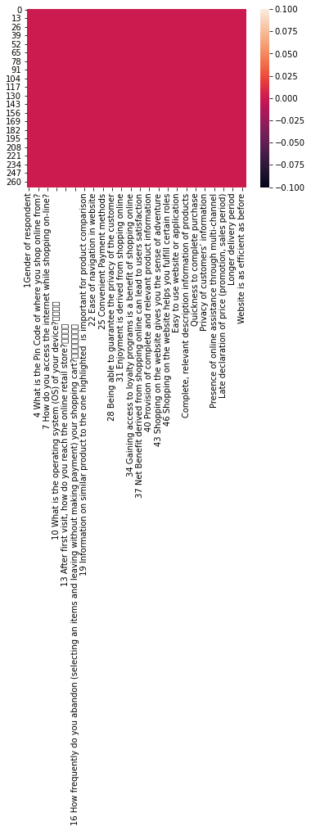
BASIC DETAILS OF NULL VARIABLES
THE IS NO NULL VARIABLE PRESENT IN THE DATASET,REF:HEATMAP FOR NULL VALUES

Slide 6
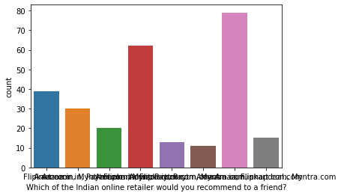
Target Analysis
The target column is,
“Which of the Indian online retailer would you recommend to a friend?”
Amazon.in 79
Amazon.in, Flipkart.com 62
Flipkart.com 39
Amazon.in, Myntra.com 30
Amazon.in, Paytm.com, Myntra.com 20
Amazon.in, Flipkart.com, Myntra.com 15
Amazon.in, Paytm.com 13
Flipkart.com, Paytm.com, Myntra.com, snapdeal.com 11

Slide 7
Target Analysis
The target column is,
The target column is:- “Which of the Indian online retailer would you recommend to a friend?”
By analysing the target column it is clear that it has 8 different classes.
So it is a classification type problem.
Moreover we have to balance the target column after analysis and splitting process.

Slide 8
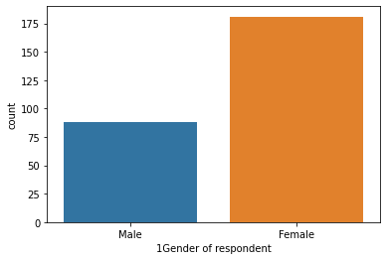
Feature columns Analysis
The column univariate analysis: Gender
FEMALE =181
MALE =88

Slide 9
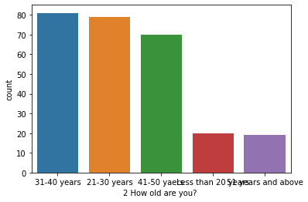
Feature columns Analysis
The column univariate analysis: AGE
31-40 years 81
21-30 years 79
41-50 yaers 70
Less than 20 years 20
51 years and above 19

Slide 10
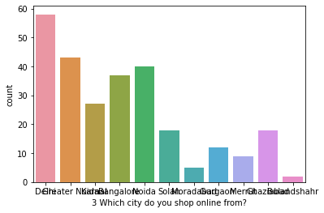
Feature columns Analysis
The column univariate analysis: CITY
Delhi 58
Greater Noida 43
Noida 40
Bangalore 37
Karnal 27
Solan 18
Ghaziabad 18
Gurgaon 12
Merrut 9
Moradabad 5
Bulandshahr 2

Slide 11
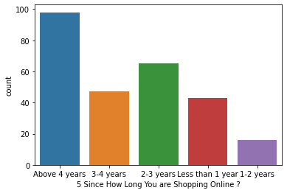
Feature columns Analysis
The column univariate analysis: AGE
Above 4 years 98
2-3 years 65
3-4 years 47
Less than 1 year 43
1-2 years 16

Slide 12
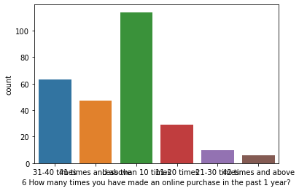
Feature columns Analysis
The column univariate analysis: Repeat purchase in year
Less than 10 times 114
31-40 times 63
41 times and above 47
11-20 times 29
21-30 times 10
42 times and above 6

Slide 13
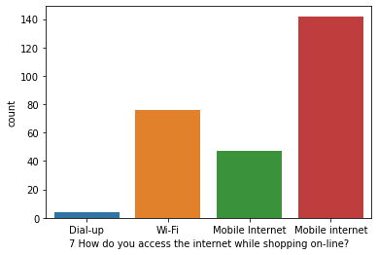
Feature columns Analysis
The column univariate analysis: data access
Mobile internet 142
Wi-Fi 76
Mobile Internet 47
Dial-up 4

Slide 14
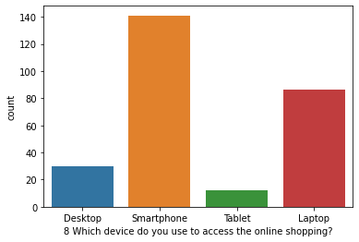
Feature columns Analysis
The column univariate analysis: Device
Smartphone 141
Laptop 86
Desktop 30
Tablet 12

Slide 15
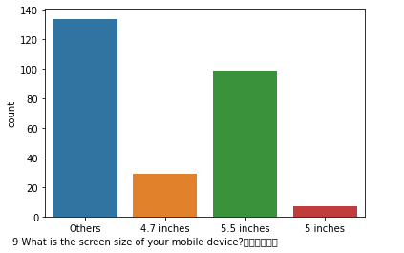
Feature columns Analysis
The column univariate analysis: SCREEN SIZE
Others 134
5.5 inches 99
4.7 inches 29
5 inches 7

Slide 16
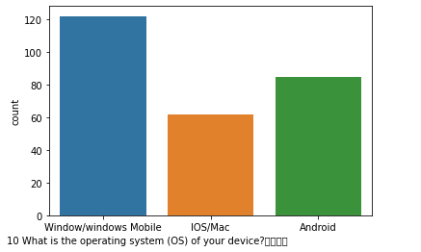
Feature columns Analysis
The column univariate analysis: OS
Window/windows Mobile 122
Android 85
IOS/Mac 62

Slide 17
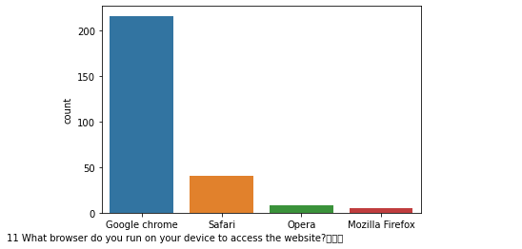
Feature columns Analysis
The column univariate analysis: BROWSER
Google chrome 216
Safari 40
Opera 8
Mozilla Firefox 5

Slide 18
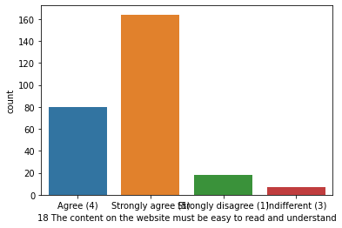
Feature columns Analysis
The column univariate analysis: EASYNESS IN READING
Strongly agree (5) 116
Agree (4) 92
Indifferent (3) 43
Dis-agree (2) 18

Slide 19
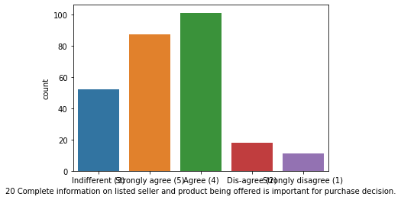
Feature columns Analysis
The column univariate analysis: PRODUCT INFORMATION
Agree (4) 101
Strongly agree (5) 87
Indifferent (3) 52
Dis-agree (2) 18
Strongly disagree (1) 11

Slide 20
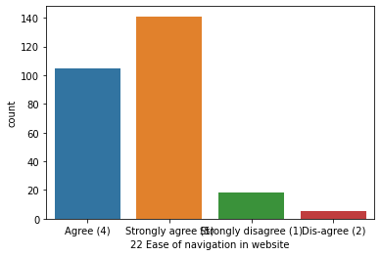
Feature columns Analysis
The column univariate analysis: EASY WEBSITE NAVIGATION
Strongly agree (5) 141
Agree (4) 105
Strongly disagree (1) 18
Dis-agree (2) 5

Slide 21
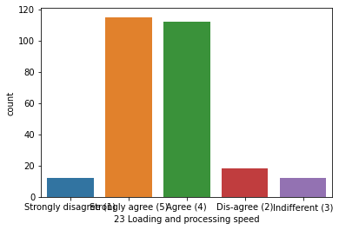
Feature columns Analysis
The column univariate analysis: SPEED
Strongly agree (5) 115
Agree (4) 112
Dis-agree (2) 18
Strongly disagree (1) 12
Indifferent (3) 12

Slide 22
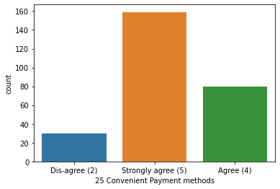
Feature columns Analysis
The column univariate analysis: PAYMENT CONVENIENCE
Strongly agree (5) 159
Agree (4) 80
Dis-agree (2) 30

Slide 23
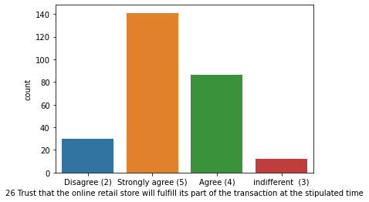
Feature columns Analysis
The column univariate analysis: TRUST
Strongly agree (5) 141
Agree (4) 86
Disagree (2) 30
indifferent (3) 12

Slide 24
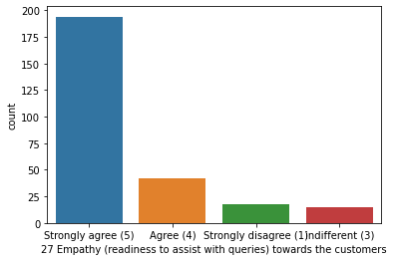
Feature columns Analysis
The column univariate analysis: EMPATHY
Strongly agree (5) 194
Agree (4) 42
Strongly disagree (1) 18
indifferent (3) 15

Slide 25
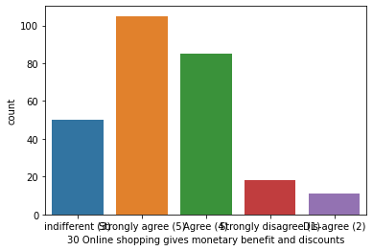
Feature columns Analysis
The column univariate analysis: BENEFITS AND DISCOUNT
Strongly agree (5) 105
Agree (4) 85
indifferent (3) 50
Strongly disagree (1) 18
Dis-agree (2) 11

Slide 26
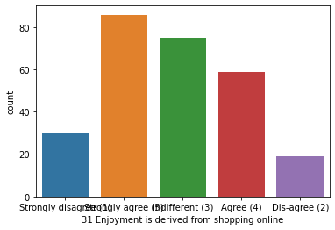
Feature columns Analysis
The column univariate analysis: ENGOYMENT FROM SHOPPING
Strongly agree (5) 86
indifferent (3) 75
Agree (4) 59
Strongly disagree (1) 30
Dis-agree (2) 19

Slide 27
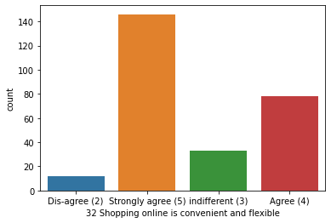
Feature columns Analysis
The column univariate analysis: FLEXIBILITY
Strongly agree (5) 146
Agree (4) 78
indifferent (3) 33
Dis-agree (2) 12

Slide 28
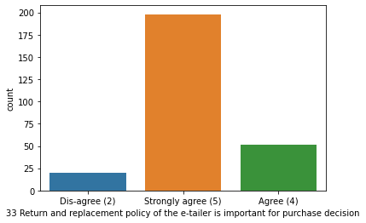
Feature columns Analysis
The column univariate analysis: REPLACEMENT POLICY
Strongly agree (5) 198
Agree (4) 51
Dis-agree (2) 20

Slide 29
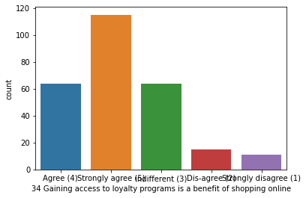
Feature columns Analysis
The column univariate analysis: ACCESS TO LOYALTY PROGRAM
Strongly agree (5) 115
indifferent (3) 64
Agree (4) 64
Dis-agree (2) 15
Strongly disagree (1) 11

Slide 30
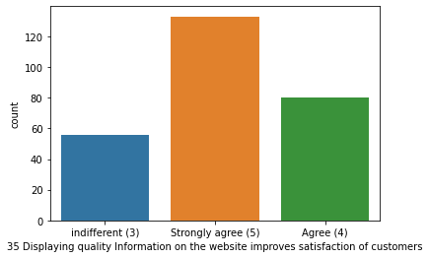
Feature columns Analysis
The column univariate analysis: DISPLAY QUALITY INFORMATION
Strongly agree (5) 133
Agree (4) 80
indifferent (3) 56

Slide 31
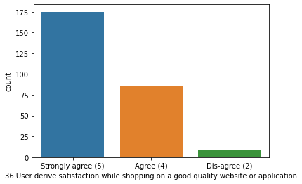
Feature columns Analysis
The column univariate analysis: QUALITY WEBSITE
Strongly agree (5) 175
Agree (4) 86
Dis-agree (2) 8

Slide 32
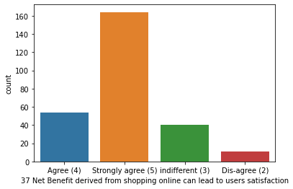
Feature columns Analysis
The column univariate analysis: USER SATISFACTION FROM BENEFITS
Strongly agree (5) 164
Agree (4) 54
indifferent (3) 40
Dis-agree (2) 11

Slide 33
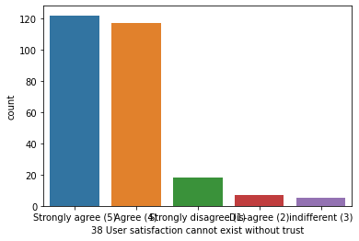
Feature columns Analysis
The column univariate analysis: USER SATISFACTION IN TRUST
Strongly agree (5) 122
Agree (4) 117
Strongly disagree (1) 18
Dis-agree (2) 7
indifferent (3) 5

Slide 34
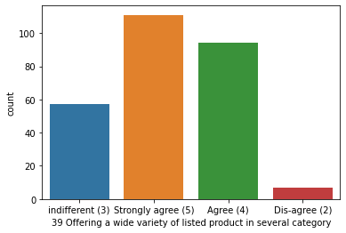
Feature columns Analysis
The column univariate analysis: VARIETY IN LISTED CATEGORY ITEMS
Strongly agree (5) 111
Agree (4) 94
indifferent (3) 57
Dis-agree (2) 7

Slide 35
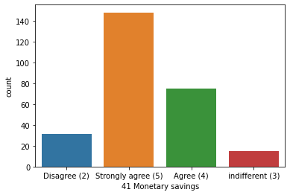
Feature columns Analysis
The column univariate analysis: MONETARY SAVING
Strongly agree (5) 148
Agree (4) 75
Disagree (2) 31
indifferent (3) 15

Slide 36
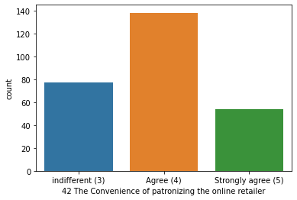
Feature columns Analysis
The column univariate analysis: PATRONIZING CONVENIENCE
Agree (4) 138
indifferent (3) 77
Strongly agree (5) 54

Slide 37
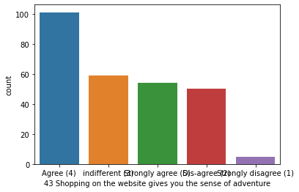
Feature columns Analysis
The column univariate analysis: SHOPPING GIVES SENCE OF ADVENTURE
Agree (4) 101
indifferent (3) 59
Strongly agree (5) 54
Dis-agree (2) 50
Strongly disagree (1) 5

Slide 38
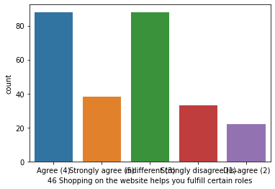
Feature columns Analysis
The column univariate analysis: SHOPPING FULLFILLS SOME ROLES
indifferent (3) 88
Agree (4) 88
Strongly agree (5) 38
Strongly disagree (1) 33
Dis-agree (2) 22

Slide 39
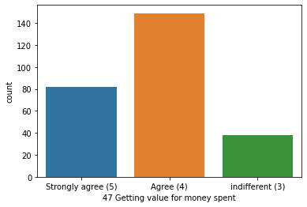
Feature columns Analysis
The column univariate analysis: VALUE FOR MONEY SPEND
Agree (4) 149
Strongly agree (5) 82
indifferent (3) 38

Slide 40
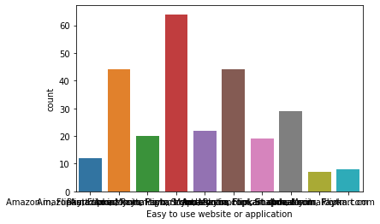
Feature columns Analysis
The column univariate analysis: EASY TO USE WEBSITE
Amazon.in, Flipkart.com, Paytm.com, Myntra.com, Snapdeal.com 64
Amazon.in, Flipkart.com 44
Amazon.in, Flipkart.com, Myntra.com, Snapdeal.com 44
Amazon.in 29
Amazon.in, Flipkart.com, Paytm.com, Snapdeal.com 22
Amazon.in, Paytm.com, Myntra.com 20
Amazon.in, Flipkart.com, Myntra.com 19
Paytm.com 12
Flipkart.com 8
Amazon.in, Paytm.com 7

Slide 41
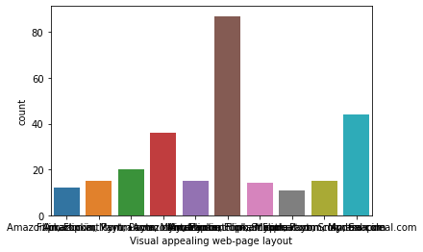
Feature columns Analysis
The column univariate analysis: VISUAL APPEALING WEBSITE
Amazon.in, Flipkart.com 87
Amazon.in 44
Amazon.in, Flipkart.com, Paytm.com, Myntra.com, Snapdeal.com 36
Amazon.in, Paytm.com, Myntra.com 20
Amazon.in, Myntra.com 15
Myntra.com 15
Flipkart.com, Myntra.com 15
Amazon.in, Flipkart.com, Myntra.com, Snapdeal.com 14
Flipkart.com 12
Amazon.in, Flipkart.com, Paytm.com, Snapdeal.com 11

Slide 42
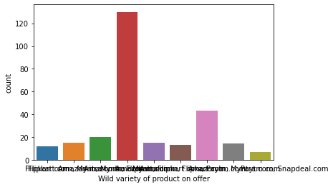
Feature columns Analysis
The column univariate analysis: VARIETY OF OFFER PRODUCTS
Amazon.in, Flipkart.com 130
Amazon.in 43
Amazon.in, Myntra.com 20
Myntra.com 15
Flipkart.com, Myntra.com 15
Amazon.in, Flipkart.com, Myntra.com, Snapdeal.com 14
Amazon.in, Flipkart.com, Paytm.com 13
Flipkart.com 12
Paytm.com 7

Slide 43
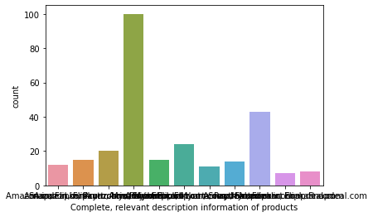
Feature columns Analysis
The column univariate analysis: COMPLETE AND RELEVENT INFO IN WEBSITE
Amazon.in, Flipkart.com 100
Amazon.in 43
Amazon.in, Flipkart.com, Paytm.com 24
Amazon.in, Paytm.com, Myntra.com 20
Amazon.in, Flipkart.com, Myntra.com 15
Amazon.in, Flipkart.com, Paytm.com, Myntra.com, Snapdeal.com 15
Amazon.in, Flipkart.com, Myntra.com, Snapdeal.com 14
Snapdeal.com 12
Flipkart.com, Snapdeal.com 11
Flipkart.com 8
Amazon.in, Flipkart.com, Snapdeal.com 7

Slide 44
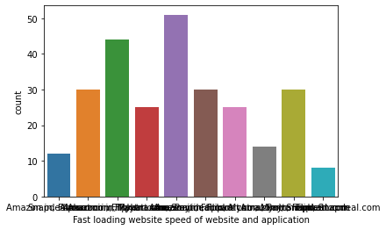
Feature columns Analysis
The column univariate analysis: FAST LOADING WEBSITE
Amazon.in 51
Amazon.in, Paytm.com 44
Amazon.in, Flipkart.com 30
Amazon.in, Flipkart.com, Myntra.com 30
Amazon.in, Flipkart.com, Paytm.com, Myntra.com, Snapdeal.com 30
Amazon.in, Flipkart.com, Snapdeal.com 25
Amazon.in, Flipkart.com, Paytm.com 25
Amazon.in, Flipkart.com, Myntra.com, Snapdeal.com 14
Snapdeal.com 12
Flipkart.com 8

Slide 45
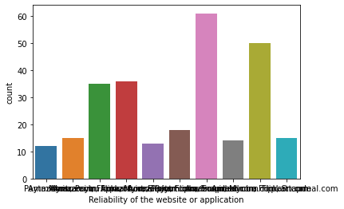
Feature columns Analysis
The column univariate analysis: RELIABLE WEBSITE APPLICATION
Amazon.in 61
Amazon.in, Flipkart.com 50
Amazon.in, Flipkart.com, Paytm.com 36
Amazon.in, Paytm.com, Myntra.com 35
Amazon.in, Flipkart.com, Snapdeal.com 18
Flipkart.com 15
Myntra.com 15
Amazon.in, Flipkart.com, Myntra.com, Snapdeal.com 14
Amazon.in, Flipkart.com, Paytm.com, Snapdeal.com 13
Paytm.com 12

Slide 46
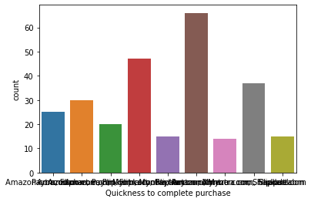
Feature columns Analysis
The column univariate analysis: QUICKNESS IN PURCHASE COMPLETION
Amazon.com 66
Amazon.com, Flipkart.com, Paytm.com 47
Amazon.com, Flipkart.com 37
Amazon.com, Flipkart.com, Myntra.com 30
Paytm.com 25
Amazon.com, Paytm.com, Myntra.com 20
Flipkart.com 15
Amazon.com, Flipkart.com, Paytm.com, Myntra.com, Snapdeal 15
Flipkart.com, Myntra.com, Snapdeal 14

Slide 47
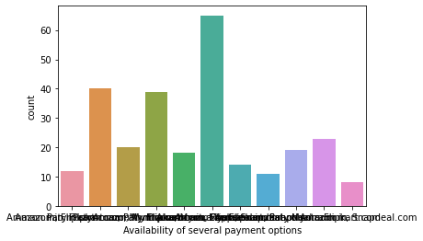
Feature columns Analysis
The column univariate analysis: AVAILABILITY OF PAYMENT OPTIONS
Amazon.in, Flipkart.com 65
Amazon.in, Flipkart.com, Myntra.com 40
Amazon.in, Flipkart.com, Patym.com, Myntra.com, Snapdeal.com 39
Amazon.in 23
Patym.com, Myntra.com 20
Amazon.in, Flipkart.com, Myntra.com, Snapdeal.com 19
Amazon.in, Flipkart.com, Snapdeal.com 18
Flipkart.com, Myntra.com, Snapdeal.com 14
Patym.com 12
Amazon.in, Patym.com 11
Flipkart.com 8

Slide 48
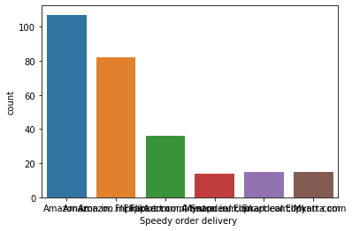
Feature columns Analysis
The column univariate analysis: SPEEDY ORDER DELIVERY
Amazon.in 107
Amazon.in, Flipkart.com 82
Amazon.in, Flipkart.com, Snapdeal.com 36
Flipkart.com 15
Amazon.in, Flipkart.com, Myntra.com 15
Flipkart.com, Myntra.com, Snapdeal.com 14

Slide 49
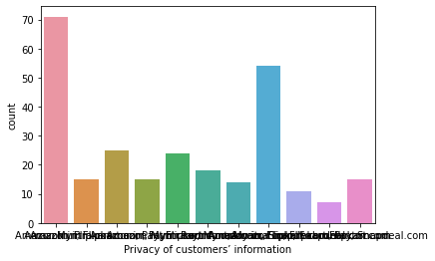
Feature columns Analysis
The column univariate analysis: PRIVACY OF CUSTOMER
Amazon.in 71
Amazon.in, Flipkart.com 54
Amazon.in, Flipkart.com, Myntra.com 25
Amazon.in, Flipkart.com, Paytm.com, Myntra.com, Snapdeal.com 24
Paytm.com 18
Amazon.in, Paytm.com 15
Flipkart.com 15
Myntra.com 15
Amazon.in, Flipkart.com, Myntra.com, Snapdeal.com 14
Amazon.in, Flipkart.com, Paytm.com 11
Amazon.in, Flipkart.com, Snapdeal.com 7

Slide 50
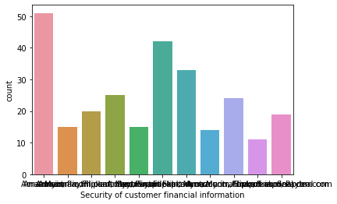
Feature columns Analysis
The column univariate analysis: CUSTOMER PAYMENT SECURITY
Amazon.in 51
Amazon.in, Flipkart.com, Paytm.com, Myntra.com, Snapdeal.com 42
Flipkart.com 33
Amazon.in, Flipkart.com, Snapdeal.com 25
Amazon.in, Flipkart.com 24
Amazon.in, Paytm.com, Myntra.com 20
Amazon.in, Snapdeal.com 19
Paytm.com 15
Myntra.com 15
Amazon.in, Flipkart.com, Myntra.com, Snapdeal.com 14
Amazon.in, Flipkart.com, Paytm.com 11

Slide 51
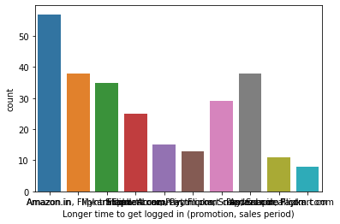
Feature columns Analysis
The column univariate analysis: LONGER TIME LOGG IN
Amazon.in 57
Paytm.com 38
Amazon.in, Flipkart.com 38
Myntra.com 35
Amazon.in, Flipkart.com, Snapdeal.com 29
Snapdeal.com 25
Flipkart.com, Paytm.com 15
Flipkart.com, Paytm.com, Snapdeal.com 13
Amazon.in, Paytm.com 11
Flipkart.com 8

Slide 52
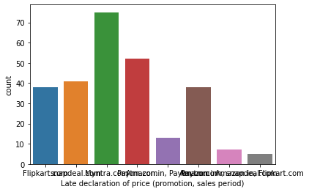
Feature columns Analysis
The column univariate analysis: LATE DECLARATION OF PRICE
Myntra.com 75
Paytm.com 52
snapdeal.com 41
Flipkart.com 38
Amazon.in 38
Amazon.in, Paytm.com 13
Paytm.com, snapdeal.com 7
Amazon.in, Flipkart.com 5

Slide 53
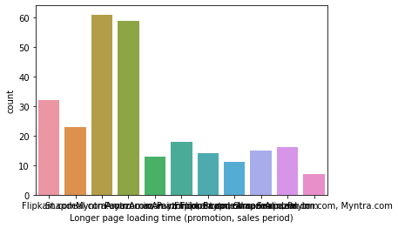
Feature columns Analysis
The column univariate analysis: LONGER PAGE LOADING TIME
Myntra.com 61
Paytm.com 59
Flipkart.com 32
Snapdeal.com 23
Amazon.in, Flipkart.com 18
Amazon.in 16
Paytm.com, Snapdeal.com 15
Amazon.in, Snapdeal.com 14
Amazon.in, Paytm.com 13
Flipkart.com, Snapdeal.com 11
Amazon.in, Paytm.com, Myntra.com 7

Slide 54
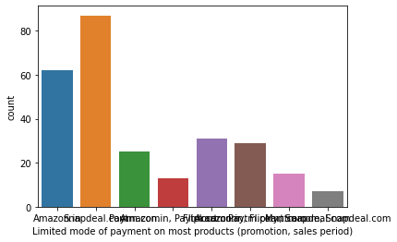
Feature columns Analysis
The column univariate analysis: LIMITED MODE OF PAYMENT
Snapdeal.com 87
Amazon.in 62
Flipkart.com 31
Amazon.in, Flipkart.com 29
Paytm.com 25
Paytm.com, Snapdeal.com 15
Amazon.in, Paytm.com 13
Myntra.com, Snapdeal.com 7

Slide 55
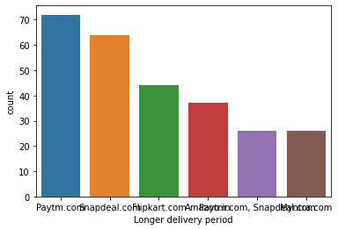
Feature columns Analysis
The column univariate analysis: LONG DELIVERY PERIOD
Paytm.com 72
Snapdeal.com 64
Flipkart.com 44
Amazon.in 37
Paytm.com, Snapdeal.com 26
Myntra.com 26

Slide 56

Feature columns Analysis
The column univariate analysis: MOVING DISRUPTION PAGE TO PAGE
Amazon.in 53
Myntra.com 52
Snapdeal.com 49
Paytm.com 39
Flipkart.com 26
Amazon.in, Flipkart.com 25
Myntra.com, Snapdeal.com 14
Flipkart.com, Snapdeal.com 11

Slide 57

Feature columns Analysis
The column univariate analysis: WEBSITE IS EFFICIENT AS BEFORE
Amazon.in 94
Flipkart.com 47
Amazon.in, Flipkart.com 45
Amazon.in, Flipkart.com, Paytm.com 25
Amazon.in, Paytm.com 18
Paytm.com 15
Myntra.com, Snapdeal.com 14
Snapdeal.com 11

Slide 58
ANALYSIS-DROPPING
After analysing different columns in the dataset it is clear that some of them are unwanted to the target variables.
Specially some columns containing personal information, gadget information, data connection informations etc
Dropping those columns which are not necessary for target .

Slide 59
Encoding
After analysing different columns in the dataset we need to analyse the correlation of datasets..
For analysing using correlation and heat map we have to use an efficient encoder .
Here used ordinal encoder for encoding object to float.

Slide 60

Correlation and heat map analysis

Slide 61
MULTICOLLINEARITY-VIF
Here analysing heat map want to check multi collinearity.
Without manual method preferred VIF for checking multicollinearity.
VIF values showing perfect values.

Slide 62
Splitting and scaling features
Here after splitting dataset to x and y applied scaling.
Used standard scalar for scaling feature columns(x).

Slide 63
SAMPLING TECHNIQUE
Our target contains un even classes ,to balance this classes we can use sampling techniques.
Used SMOTE-Upsampling technique for balancing.

Slide 64
CONCLUSION
By analysing target variable we come to conclusion that ,this is a classification type model.
By analysing features we dropped some unwanted feature columns.
Encoded the data using ordinal encoder.
Verified the correlation.
To check multicollinearity applied VIF.
To balancing target applied SMOTE.
Now x and y are ready for further analysis.

